Slide 1

VOICE DATA ANALYSIS
Sharvari Nagesh

Slide 2
Problem Statement
This project is to classify the voice data as male or female. The data is taken from INSAID Git hub page. The data needs to be classified based upon acoustic properties of the voice and speech. The dataset consists of 3,168 recorded voice samples, collected from male and female speakers. The voice samples are pre-processed .
Acoustic properties are measured for each voice and included in the data. Using these properties we need to see how well the different classification Machine learning algorithms can identify if it is a male voice or a female voice.

Slide 3
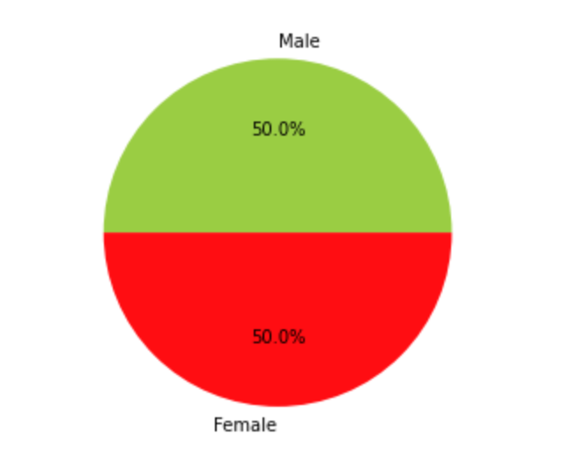
Data Interpretation and Visualization
Data includes various properties of voice like, mean, median and skewness of frequency. range of dominance, spectral flatness, kurtosis, skewness of voice etc .
Some of the columns are co-related to each other and has been removed to simplify the data
There are equal number of male and female voice record samples as shown in the pie chart here. So there will not be any weightage to any one type of data

Slide 4
Selection of Algorithms
Since this is a classification problem, 3 classification algorithms are considered. Data analysis is done using all the 3 algorithms to compare their performances. The algorithms considered are:
Logistic regression : Logistic regression is a supervised learning technique which helps in classification problems. Sigmoid function or logistic function is used as hypothesis function for logistic regression.
Naive Bayes: A Naive Bayes classifier uses probability theory to classify data. Naive Bayes classifier algorithms make use of Bayes' theorem.
K-Nearest Classifier : K-Nearest Neighbours is one of the most basic yet essential classification algorithms which belongs to the supervised learning domain. KNN Algorithm is based on feature similarity. K nearest points are considered for deciding the class of the data point. Choosing the right value of k is a process called parameter tuning, and is important for better accuracy.

Slide 5
Model Evaluation Technique Used
In this exercise, we are interested in how well the algorithms can classify the voice data as male/female. we are not interested in giving importance to any one type of classification, like classifying male voice is more important than female or vice versa. so recall or precision score is not important here. So only Accuracy_score is used to evaluate the models.
Also, the data is equally distributed among the 2 classes(male/female). Accuracy score performs well when the data is balanced between the classes. Only accuracy score is enough for comparing the results of various data here.

Slide 6
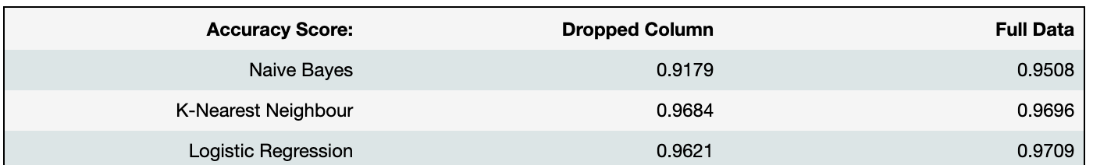
Model Comparison
Observation :
Both K-Nearest neighbour and Logistic regression are giving better accuracy than Naive Bayes. The calculation is done with few correlated columns dropped from the data and also without dropping any columns. When columns are not dropped, all the algorithms improve on accuracy, though, Naive Bayes has improved considerably.

